Slide 1

Industrial Automation (ICE 3252)
PLC Programming- Data Transfer, Arithmetic & Program Control Instructions (SKIP, MCR)
Bipin Krishna
Assistant Professor (Sr.)
ICE Department
Manipal Institute of Technology
MAHE, Karnataka, India

Slide 2
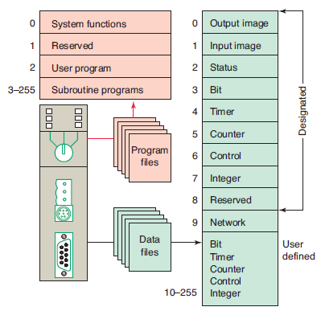
Processor Memory Organization
Program and data file organization for the SLC 500 controller.
Program files
System functions (file 0) —This file is always included and contains various system-related information and user-programmed information such as processor type, I/O configuration, processor file name, and password.
Reserved (file 1) —This file is reserved by the processor and is not accessible to the user.
Main ladder program (file 2) —This fi le is always included and contains user-programmed instructions that define how the controller is to operate.
Subroutine ladder program (files 3–255) —These files are user-created and are activated according to subroutine instructions residing in the main ladder program file.

Slide 3
Data Files
The data fi le portion of the processor’s memory stores input and output status, processor status, the status of various bits, and numerical data. All this information is accessed via the ladder logic program. These fi les are organized by the type of data they contain and may include:
Output (file 0) —This file stores the state of the output terminals for the controller.
Input (file 1) —This file stores the status of the input terminals for the controller.
Status (file 2) —This file stores controller operation information and is useful for troubleshooting controller and program operation.
Bit (file 3) —This file is used for internal relay logic storage.
Timer (file 4) —This file stores the timer accumulated and preset values and status bits.
Counter (file 5) —This file stores the counter accumulated and preset values and status bits.
Control (file 6) —This file stores the length, pointer position, and status bit for specific instructions such as shift registers and sequencers.
Integer (file 7) —This file is used to store numerical values or bit information.
Reserved (file 8) —This file is not accessible to the user.
Network communications (file 9) —This file is used for network communications if installed or used like fi les 10–255.
User-defined (files 10–255) —These files are user defined as bit, timer, counter, control, and/or integer data storage.

Slide 4
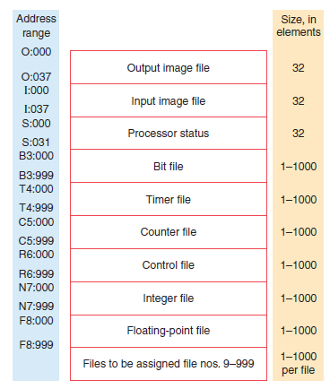
Data fi le memory organization for an Allen-Bradley PLC-5 controller.

Slide 5
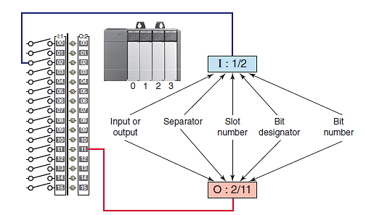
The I/O address format for the SLC family of PLCs
The format consists of the following three parts:
Part 1: I for input, and a colon to separate the module type from the slot. O for output and a colon to separate the module type from the slot.
Part 2: The module slot number and a forward slash to separate the slot from the terminal screw.
Part 3: The screw terminal number.

Slide 6
Data Manipulation instructions
Data manipulation instructions allow numerical data stored in the controller’s memory to be operated on within the control program.
Each data manipulation instruction requires two or more words of data memory for operation. The words of data memory in singular form may be referred to either as registers or as words, depending on the manufacturer.
The terms table or file are generally used when a consecutive group of related data memory words is referenced.
The data manipulation instructions allow the movement, manipulation, or storage of data in either single- or multiple-word groups from one data memory area of the PLC to another.

Slide 7
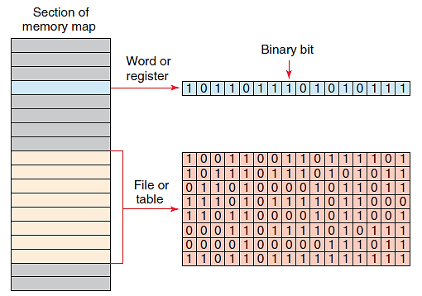
Data files, words, bits
Data Files

Slide 8
Move/Logical instructions
MOV (Move) —Moves the source value to the destination.
MVM (Masked Move) —Moves data from a source location to a selected portion of the destination.
AND (And) —Performs a bitwise AND operation.
OR (Or) —Performs a bitwise OR operation.
XOR (Exclusive Or) —Performs a bitwise XOR operation.
NOT (Not) —Performs a bitwise NOT operation.
CLR (Clear) —Sets all bits of a word to zero.

Slide 9
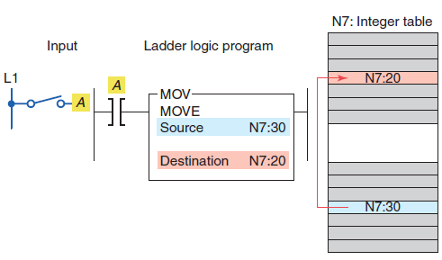
MOV instruction

Slide 10
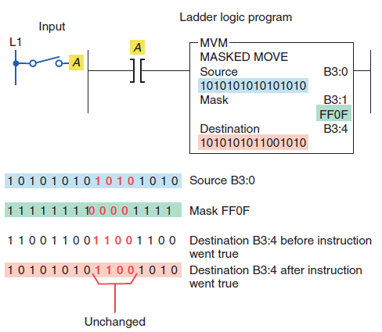
MVM(Move with Mask)
The pattern of characters in the mask determines which source bits will be passed through to the destination address.
The bits in the mask that are set to zero (0) do not pass data.
Only the bits in the mask that are set to one (1) will pass the source data through to the destination.
Bits in the destination are not affected when the corresponding bits in the mask are zero.
The MVM instruction is used to copy the desired part of a 16-bit word by masking the rest of the value.

Slide 11
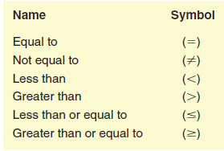
Data Compare Instructions
EQU (Equal) —Tests whether two values are equal.
NEQ (Not Equal) —Tests whether one value is not equal to a second value.
LES (Less Than) —Tests whether one value is less than a second value.
GRT (Greater Than) —Tests whether one value is greater than a second value.
LEQ (Less Than or Equal) —Tests whether one value is less than or equal to a second value.
GEQ (Greater Than or Equal) —Tests whether one value is greater than or equal to a second value.

Slide 12
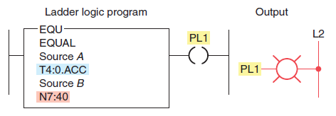
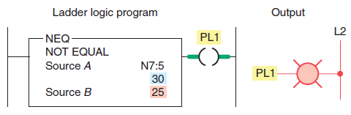
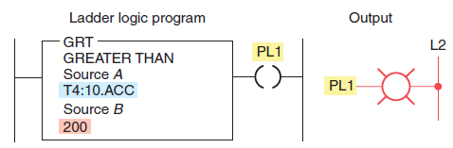
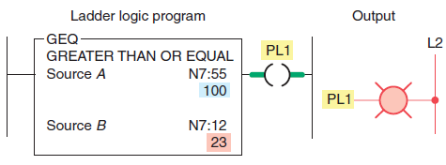
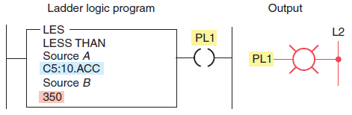
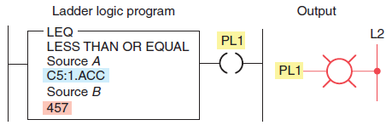
Data Compare instructions

Slide 13
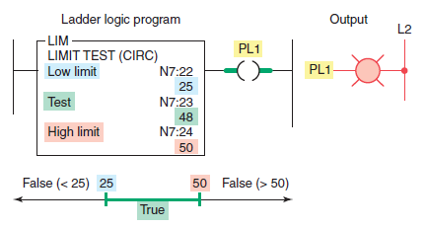
Data Compare instructions
The limit test (LIM) instruction is used to test whether values are within or outside the specified range.

Slide 14
Arithmetic Instructions
The PLC’s math functions capability allows it to perform arithmetic functions on values stored in memory words or registers.
Depending on what type of processor is used, various math instructions can be programmed.
The basic four mathematical functions performed by PLCs are:
Addition
Subtraction
Multiplication
Division

Slide 15
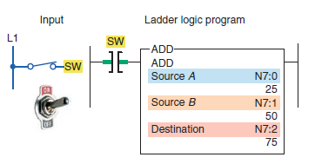
Addition Instruction
After an instruction is executed, the arithmetic status bits in the status file are updated.
Carry (C)—Address S2:0/0, is set to 1 when there is a carry in the ADD instruction or a borrow in the SUB instruction.
Overflow (O)—Address S2:0/1, is set to 1 when the result is too large to fit in the destination register.
Zero (Z)—Address S2:0/2, is set to 1 when the result of the subtract instruction is zero.
Sign (S)—Address S2:0/3, is set to 1 when the result is a negative number.

Slide 16
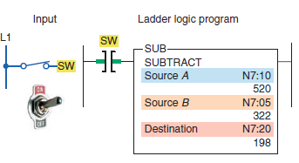
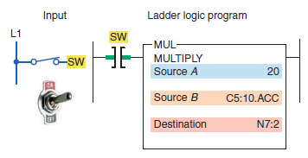
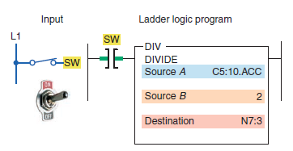
Subtraction Instruction
Multiplication Instruction
Division Instruction

Slide 17
Division..
If the remainder is 0.5 or greater, a roundup occurs in the integer destination.
The value stored in the math register consists of the unrounded quotient (placed in the most significant word) and the remainder (placed in the least significant word).
Some PLCs support the use of floating-decimal as well as integer (whole number) values. As an example, 10 divided by 3 may be expressed as 3.333333 (floating-decimal notation) or 3 with a remainder of 1.

Slide 18
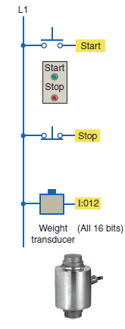
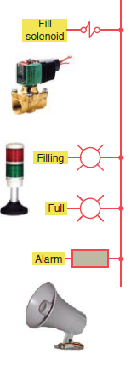
Example 1: Vessel overfill condition
This application requires an alarm to sound when a supply system leaks 5 Kg or more of raw material into the vessel after a preset weight of 500 Kg has been reached.

Slide 19
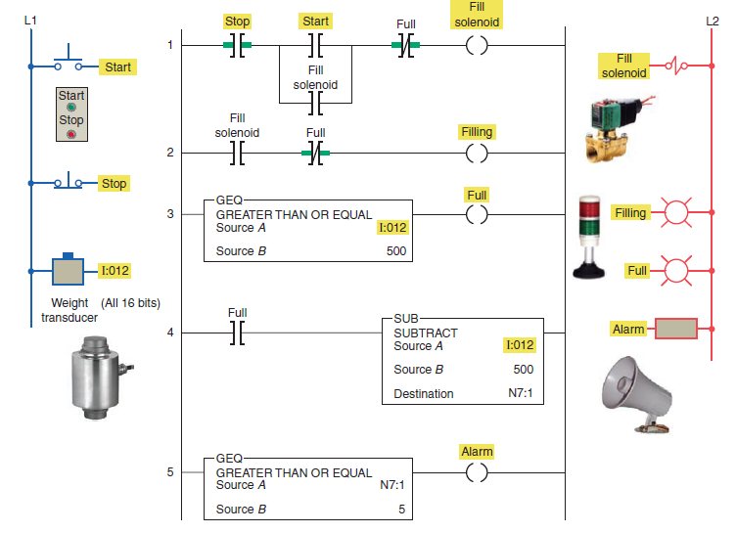

Slide 20
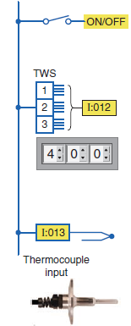
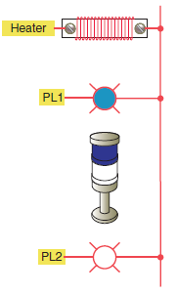
Example 2: ON/OFF temperature control
Create a ladder logic program to implement an ON/OFF controller for a temperature control process. PLC should calculate the upper and lower dead band, or off/on limits, about the set-point with +/- 1% hysteresis. Set-point temperature is adjusted by means of the thumbwheel switch.

Slide 21
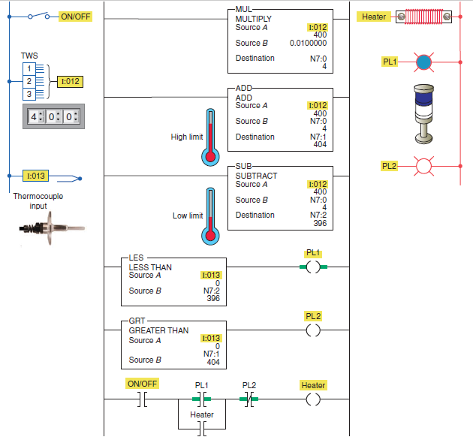

Slide 22
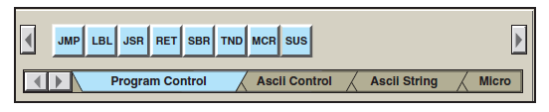
Program Control Instructions
Several output-type instructions, which are often referred to as override instructions, provide a means of executing sections of the control logic if certain conditions are met.
These program control instructions allow for greater program flexibility and greater efficiency in the program scan.
Program control instructions are used to enable or disable a block of logic program or to move execution of a program from one place to another place.

Slide 23
JMP (Jump to Label) —Jump forward/backward to a corresponding label instruction.
LBL (Label) —Specifies label location.
JSR (Jump to Subroutine) —Jump to a designated subroutine instruction.
RET (Return from Subroutine) —Exits current subroutine and returns to previous condition.
SBR (Subroutine) —Identifies the subroutine program.
TND (Temporary End) —Makes a temporary end that halts program execution.
MCR (Master Control Reset) —Clears all set nonretentive output rungs between the paired MCR instructions.
SUS (Suspend) —Identifies conditions for debugging and system troubleshooting.

Slide 24
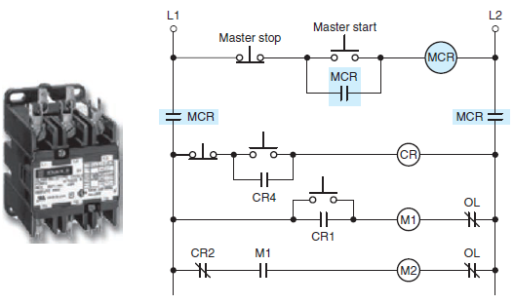
Master Control Reset Instruction

Slide 25
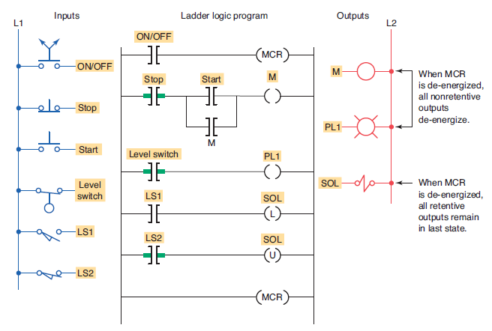

Slide 26
Jump Instruction
In PLC programming it is sometimes desirable to be able to jump over certain program instructions when certain conditions exist.
The jump (JMP) instruction is an output instruction used for this purpose.
When the jump instruction is used, the PLC will not execute the instructions of a rung that is jumped.
Some manufacturers provide a skip instruction, which is essentially the same as the jump instruction.

Slide 27
Addresses Q2:0 through Q2:255 are the addresses used for the jump (JMP) instructions.
The label (LBL) instruction is a target for the jump instruction.
In addition, the jump instruction with its associated label must have the same address.
The area of the program that the processor jumps over is defined by the locations of the jump and label instructions in the program.
If the jump coil is energized, all logic between the jump and label instructions is bypassed and the processor continues scanning after the LBL instruction.

Slide 28
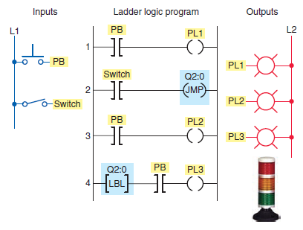
Example:

Slide 29
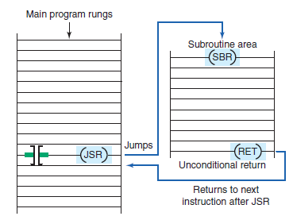
Subroutine Functions
In addition to the main ladder logic program, PLC programs may also contain additional program fi les known as subroutines.
A subroutine is a short program that is used by the main program to perform a specific function.
Large programs are often broken into subroutine program files, which are called and executed from the main program.

Slide 30
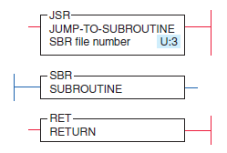
Jump to Subroutine (JSR) —The JSR instruction is an output instruction that causes the scan to jump to the program fi le designated in the instruction. Each subroutine must have a unique fi le number ( decimal 3–255).
Subroutine (SBR) —The SBR instruction is the first input instruction on the first rung in the subroutine file. It serves as an identifier that the program file is a subroutine. It is an always true instruction.
Return (RET) —The RET instruction is an output instruction that marks the end of the subroutine file. The scan returns from the end of the fi le if there is no RET instruction.

Slide 31
Reference
Frank D. Petruzella, Programmable Logic Controllers, MGH, (2e), 1997.

